Slide 1
A National Analysis, 2021-2023
ECON 642 — Panel & Non-Linear Methods
Disparities in pediatric telehealth engagement and care substitution
Presented By
Prashant Khatiwada
Course
Empirical Research Project
Data Source
MEPS 2021 - 2023
Notes:
This project examines socioeconomic and insurance disparities in pediatric telehealth use from 2021–2023, using pooled nationally representative MEPS data. I focus on two key questions: who uses telehealth, and whether telehealth supplements or replaces in-person care. The analysis applies survey-weighted nonlinear and count models consistent with ECON 642 methods.

Slide 2
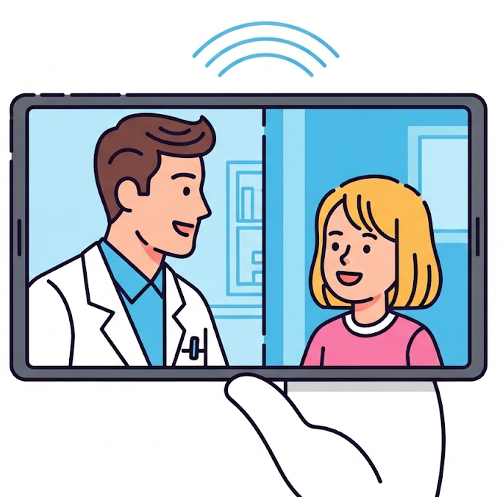
Background and Context
The COVID-19 Surge: Telehealth usage skyrocketed during the acute phase of the pandemic.
The Post-Pandemic Question: What is the role of telehealth in the "recovery" years (2021-2023)?
Equity Concerns: Did telehealth expand access for disadvantaged children, or primarily supplement care for the wealthy?
Notes:
Telehealth usage surged during the COVID-19 pandemic, but the post-pandemic pattern is uncertain—especially for children. Prior work, such as the Olfson 2023 JAMA Psychiatry paper, focuses on 2021 only and is largely mental-health-specific. We extend the time horizon to 2021–2023 and broaden the scope to all outpatient care. That gives us a clearer picture of whether telehealth became a supplementary or substitutive mode of care.

Slide 3
Research Gaps Identified
1. Data Currency - Existing national analyses stop at 2021. This study extends analysis to 2023 to test persistence.
3. Supplement vs. Substitute - Prior work counts encounters but rarely tests the mechanism. We model both visit types simultaneously.
4. Telehealth Share - Few national studies evaluate the proportion (0-1) of care delivered via telehealth using Tobit models.
2. Pediatric Focus – Most (3 papers) studies* combine adults and children, masking specific pediatric disparities. This study isolates ages 6-17.
Notes:
“Three main gaps exist:
Time limitation—most national studies end at 2021.
Equity gaps—the digital divide literature suggests disparities, but no multi-year national analysis has quantified it in children.
Care substitution—virtually no pediatric study distinguishes whether telehealth reduces in-person visits or simply adds more visits for certain groups.
My research addresses all three.”

Slide 4
Research Questions
“Among U.S. children and adolescents, do socioeconomic and insurance characteristics predict whether telehealth is used as a supplement to—or a substitute for—in-person outpatient care between 2021 and 2023?”
1. Who uses telehealth in 2021–2023?
2. Are there socioeconomic & insurance disparities?
3. Does telehealth supplement or replace in-person care?
Notes:
The central question asks whether telehealth is a complement or substitute to in-person care among U.S. children aged 6–17, and how socioeconomic and insurance characteristics shape this pattern. This is framed directly in terms of extensive margin (any telehealth) and intensive margin (counts and shares).

Slide 5
Study Hypotheses
1. Differential Access Children from higher-income/private insurance households will have a higher probability of using telehealth compared to lower-income peers.
2. Supplementation vs. Substitution – Among the SES
High SES: Supplementation (Higher TH, Stable In-Person).
Low SES: Substitution (Higher TH associated with lower In-Person) OR Exclusion.
3. Persistence Over Time Utilization will remain elevated in 2023 relative to 2021, indicating persistence beyond the acute COVID phase.
Notes:
Based on prior literature and the digital divide framework, I expect:
Differential access—higher-income and privately insured children will show higher telehealth use.
Supplement vs. substitution—higher SES groups likely supplement care, whereas lower SES groups may show substitution or exclusion effects.
Persistence—telehealth does not revert to pre-pandemic lows by 2023.

Slide 6
Conceptual Framework
SOCIOECONOMIC POSITION
(Poverty Level, Insurance Type)
│
▼
STRUCTURAL ACCESS CONSTRAINTS
(Broadband, devices, language, region)
│
▼
CHILD HEALTH NEED / DEMAND
(CSHCN, mental health, general health)
│
▼
TELEHEALTH UTILIZATION OUTCOMES
- Any telehealth use
- Telehealth visit counts
- Telehealth share (0–1)
│
▼
IN-PERSON CARE UTILIZATION
- High tele + high in-person → Supplementation
- High tele + low in-person → Substitution
│
▼
TEMPORAL MODIFIERS (2021–2023)
(Policy changes, payment shifts, tech adoption)
│
▼
EQUITY & DIGITAL DIVIDE
SES (poverty level) and insurance coverage shape a child’s structural ability to access telehealth (internet, devices, language, region). Child health needs determine demand for outpatient care. Together, these factors influence whether telehealth is used at all, how much it is used, and whether it substitutes for or supplements in-person visits. Year (2021–2023) modifies these relationships as policies and technology evolve.
Notes:
This study examines how socioeconomic resources, insurance coverage, and structural access factors influence a family’s ability to engage with telehealth. It considers how these factors, along with child health needs, determine telehealth utilization patterns and whether telehealth is used as a supplement or substitute for in-person care.

Slide 7
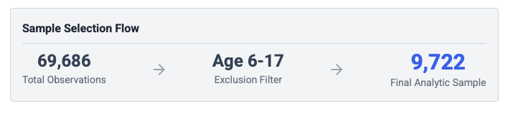
Data Source and Study Population
Medical Expenditure Panel Survey (MEPS)
Pooled Person-Year Dataset:
2021, 2022, 2023.
Target Population:
Children Ages 6–17.
Files Linked:
Full-Year Consolidated (FYC) + Office-Based (OB) + Outpatient (OP).
Identification:
TELEHEALTHFLAG used to identify video/phone visits.
Notes:
“We use MEPS 2021–2023 Full-Year Consolidated data merged with Office-Based and Outpatient visit files. The study population is children aged 6–17. Telehealth is identified using the TELEHEALTHFLAG variable in the event files and aggregated to the person-year level. All analyses are weighted using MEPS survey design variables: VARSTR, VARPSU, and PERWTxxF.”

Slide 8
Key Variables
Category | Variable | Definition / Description
Outcome Measures | Any telehealth use | Binary indicator =1 if ≥1 telehealth visit (TELEHEALTHFLAG).
 | Telehealth visits (count) | Number of OB/OP encounters delivered via telehealth.
 | In-person visits (count) | Number of OB/OP encounters not delivered via telehealth.
 | Telehealth share (0–1) | Telehealth visits ÷ total visits; modeled using Tobit due to censoring.
Key Independent Variables | Poverty category (POVCAT) | <100% FPL; 100–199% FPL; 200–399% FPL; ≥400% FPL.
 | Insurance coverage (INSCOV) | Private; Public only; Uninsured.
 | Survey year | 2021, 2022, 2023 (captures temporal trends).
 | Interaction terms | Income × Year; Insurance × Year (tests substitution vs. supplementation).
Covariates | Age | Continuous; also grouped (6–11, 12–17).
 | Sex | Male/Female.
 | Race/ethnicity | Hispanic; NH White; NH Black; NH Other.
 | Parental education | Years of education (EDUCYR).
 | Family size category | 1, 2, 3, or ≥4 persons.
 | Region | Northeast; Midwest; South; West.
 | Survey design variables | VARSTR, VARPSU, unified person-weight (PERWTxxF → weight).
Plus – mental_health, physical_health, language_barrier
CSHCN: Children with Special Health Care Needs (composite),
Notes:
Exposure variables include insurance type, family income as a percentage of poverty, race/ethnicity, and age groups. Outcomes include:
Any telehealth use (binary),
Number of telehealth visits,
Number of in-person visits,
Telehealth share = TH / (TH + in-person).
All models control for demographic, chronic conditions, and region.

Slide 9
Descriptive Statistics: Table 1
Characteristic | 2021(N = 3,962) | 2022(N = 3,127) | 2023(N = 2,633) | Total(N = 9,722)
Age, Mean (SD) | 11.57 (3.45) | 11.64 (3.43) | 11.64 (3.43) | 11.61 (3.44)
Age Group
6–11 years | 1,946 (49.12) | 1,516 (48.48) | 1,296 (49.22) | 4,758 (48.94)
12–17 years | 2,016 (50.88) | 1,611 (51.52) | 1,337 (50.78) | 4,964 (51.06)
Sex
Female | 1,903 (48.03) | 1,497 (47.87) | 1,290 (48.99) | 4,690 (48.24)
Male | 2,059 (51.97) | 1,630 (52.13) | 1,343 (51.01) | 5,032 (51.76)
Race & Ethnicity
Hispanic | 1,404 (35.44) | 946 (30.25) | 776 (29.47) | 3,126 (32.15)
NH White | 1,537 (38.79) | 1,301 (41.61) | 1,126 (42.76) | 3,964 (40.77)
NH Black | 594 (14.99) | 498 (15.93) | 396 (15.04) | 1,488 (15.31)
NH Asian | 177 (4.47) | 155 (4.96) | 164 (6.23) | 496 (5.10)
Other/Multiple | 250 (6.31) | 227 (7.26) | 171 (6.49) | 648 (6.67)
Insurance Coverage
Private | 1,912 (48.26) | 1,619 (51.77) | 1,410 (53.55) | 4,941 (50.82)
Public Only | 1,919 (48.44) | 1,408 (45.03) | 1,144 (43.45) | 4,471 (45.99)
Uninsured | 131 (3.31) | 100 (3.20) | 79 (3.00) | 310 (3.19)
Family Income (FPL)
<100% (Poor) | 929 (23.45) | 682 (21.81) | 509 (19.33) | 2,120 (21.81)
100–199% (Low Income) | 915 (23.09) | 679 (21.71) | 598 (22.71) | 2,192 (22.55)
200–399% (Middle) | 1,079 (27.23) | 902 (28.85) | 736 (27.95) | 2,717 (27.95)
≥400% (High) | 1,039 (26.22) | 864 (27.63) | 790 (30.00) | 2,693 (27.70)
Health Need & Access
CSHCN (Yes) | 695 (17.54) | 588 (18.80) | 556 (21.12) | 1,839 (18.92)
Fair/Poor Physical Health | 109 (2.75) | 67 (2.14) | 66 (2.51) | 242 (2.49)
Fair/Poor Mental Health | 186 (4.69) | 126 (4.03) | 138 (5.24) | 450 (4.63)
Language Barrier (Yes) | 726 (18.32) | 512 (16.37) | 346 (13.14) | 1,584 (16.29)
Notes:
This table summarizes the socioeconomic distribution of the sample.
Telehealth users skew older within pediatric ages, more often from higher-income families, and more likely to hold private insurance.
These patterns preview the disparities confirmed in regression models.

Slide 10
Descriptive Statistics: Table 1
Sample Composition: The analytic sample includes 9,722 children ages 6–17. Over the study period, the proportion of Hispanic children decreased (35.4% in 2021 vs. 29.5% in 2023), while the proportion of Non-Hispanic Asian children increased (4.5% in 2021 vs. 6.2% in 2023).
Socioeconomic Trends: The unweighted sample shows a shift toward higher socioeconomic status over time. The proportion of children in high-income families (>400% FPL) grew (26.2% in 2021 vs. 30.0% in 2023), and private insurance coverage also increased (48.3% in 2021 vs. 53.6% in 2023).
Health Needs: The prevalence of children identified with Special Health Care Needs (CSHCN) showed a steady increase during the post-pandemic period (17.5% in 2021 vs. 21.1% in 2023).
Access Barriers: The proportion of interviews conducted in a language other than English—a proxy for potential language barriers—decreased over the three years (18.3% in 2021 vs. 13.1% in 2023).

Slide 11
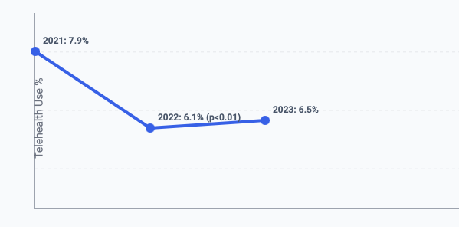
Descriptive Statistics: Trends
Time (in years) --->
"Weighted telehealth use declined from 7.9% in 2021 to 6.1% in 2022 and stabilized in 2023."
Notes:
Telehealth use declined from 7.9% in 2021 to 6.1% in 2022, then plateaued in 2023. This suggests telehealth did not collapse post-pandemic but stabilized at higher-than-pre-pandemic levels.

Slide 12
Panel C: Disparities in Healthcare Utilization (Weighted Means)
Group | Any Telehealth Use | Mean Telehealth Visits | Mean In-Person Visits
Poverty Status
<100% FPL (Poor) | 0.043 | 0.23 | 3.25
100–199% FPL (Low) | 0.056 | 0.41 | 3.64
200–399% FPL (Middle) | 0.064 | 0.52 | 3.64
≥400% FPL (High) | 0.088 | 0.51 | 5.10
Insurance Status
Private | 0.080 | 0.50 | 4.59
Public Only | 0.054 | 0.40 | 3.49
Uninsured | 0.014 | 0.01 | 2.03
Race & Ethnicity
Hispanic | 0.062 | 0.36 | 3.61
Non-Hispanic White | 0.084 | 0.61 | 5.20
Non-Hispanic Black | 0.031 | 0.19 | 2.08
Non-Hispanic Asian | 0.040 | 0.07 | 2.60
Health Need
CSHCN: Yes | 0.187 | 1.58 | 11.44
CSHCN: No | 0.041 | 0.18 | 2.39
Mental Health: Fair/Poor | 0.234 | 1.99 | 11.91
Mental Health: Good+ | 0.061 | 0.38 | 3.76
Access
Language Barrier: Yes | 0.042 | 0.24 | 2.96
Language Barrier: No | 0.072 | 0.48 | 4.26

Slide 13
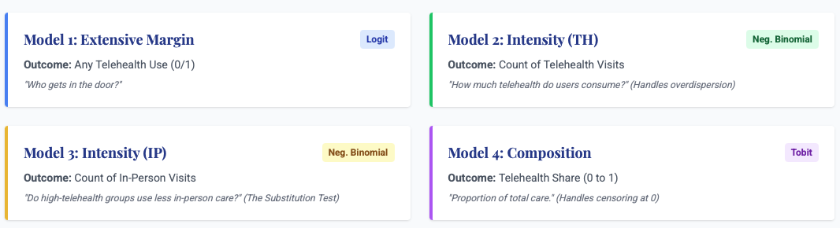
Inferential Statistics
Four distinct models to capture the extensive and intensive margins of care.
All models apply MEPS survey weights
survey weights (PERWTxxF), variance strata (VARSTR), and PSU (VARPSU).
Notes:
We estimate four models:
Logit: Any telehealth use.
Negative binomial: Count of telehealth visits.
Negative binomial: Count of in-person visits.
Fractional logit: Telehealth share.
Survey weights and design structure correctly applied. These models allow us to study both extensive and intensive margins.

Slide 14
Access (Model 1): Barriers to Telehealth Access
(Logistic Regression)
Research Question: What socioeconomic and demographic factors predict whether a child uses any telehealth services?
Key Findings:
Digital Divide Persists: High-income children (>400% FPL) had significantly higher odds of using telehealth compared to poor children ($\beta$=0.72, $p$=0.003), even after controlling for health needs.
Racial Barrier: Non-Hispanic Black children were significantly less likely to access telehealth than Hispanic children ($\beta$=-0.70, $p$=0.013), suggesting structural barriers beyond income.
Driven by Need: Children with Special Health Care Needs (CSHCN) and fair/poor mental health were the strongest predictors of use ($p$<0.001), confirming telehealth's role for vulnerable clinical populations.
Notes:
Logistic regression revealed significant socioeconomic and racial disparities in access to telehealth. After adjusting for health needs and insurance, children in high-income households (>400% FPL) had significantly higher odds of using telehealth compared to children in poverty (AOR [calculate exp(0.72) ≈ 2.05]; p=0.003). Conversely, Non-Hispanic Black children were significantly less likely to access telehealth services than Hispanic children (p=0.013). Clinical need was a strong driver of access, with children having Special Health Care Needs (CSHCN) or fair/poor mental health showing the highest probability of utilization
In – Detail logistic regression results (Model 1) in log file, here are three significant findings:
A Persistent "Digital Divide" by Income: Even after controlling for insurance and health needs, children in high-income households (>400% FPL) had significantly higher odds of accessing telehealth compared to children in poverty (Coeff = 0.72, p=0.003), confirming that financial resources remain a key driver of digital access.
Significant Racial Disparities for Black Children: Non-Hispanic Black children were significantly less likely to use telehealth services than Hispanic children (Coeff = -0.70, p=0.013), identifying a specific barrier for this group that is not explained by socioeconomic status or clinical need.
High Utility for Vulnerable Groups despite Declining Overall Access: While overall probability of telehealth use dropped significantly in 2022 (p=0.007) and 2023 (p=0.026) compared to 2021, telehealth remains a critical modality for vulnerable populations, with strong positive associations found for children with Special Health Care Needs (p<0.001) and those with fair/poor mental health (p<0.001).

Slide 15
marginsplot
Notes:
Telehealth use declines for all socioeconomic groups from 2021 to 2023, with no sign of recovery. Higher-income and privately insured children consistently show the highest predicted probabilities, while uninsured children remain near the floor. The socioeconomic gradient is stable and persistent, suggesting telehealth remains disproportionately used by more advantaged families even as overall utilization falls.

Slide 16
Intensity (Model 2): Telehealth Visit Intensity
(Negative Binomial Regression)
Research Question: Do socioeconomic and demographic factors shape how many telehealth visits a child receives among users?
Why Negative Binomial? In-person visit counts are over-dispersed (variance > mean)
Strong SES Gradient:
Higher-income children (>400% FPL) had ~3× more visits than poor children (IRR = 2.84, p = 0.016). Low- and middle-income groups also showed significantly higher use.
Insurance Gap:
Uninsured children had near-zero telehealth volume (IRR = 0.06, p < 0.001).
Public-only ≈ Private (ns).
Racial Differences:
NH Black (IRR = 0.41) and NH Asian (IRR = 0.19) children had substantially fewer visits than Hispanic children.
Clinical Need Dominates:
CSHCN had ~10× more visits (p < 0.001); poor mental health ~2.5× (p = 0.001).
Notes:
Why Negative Binomial?
Telehealth visit counts are over-dispersed (variance >> mean). Poisson would misfit; NB handles this correctly.
Negative binomial regression revealed that the intensity of telehealth utilization was heavily stratified by income. After adjusting for clinical need, children in high-income households (>400% FPL) had a telehealth visit rate 2.84 times higher than children in poverty (IRR 2.84; p=0.016). Significant racial disparities were also observed, with Non-Hispanic Black (IRR 0.41) and Asian (IRR 0.19) children having significantly lower visit rates than Hispanic children. Clinical complexity was the strongest predictor of intensity: children with Special Health Care Needs (CSHCN) had visit rates nearly 10 times higher than their peers (IRR 9.57; p<0.001).

Slide 17
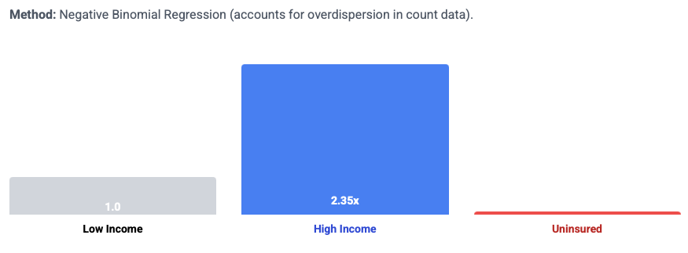
Model 2: Telehealth Visits Counts
3
Interpretation: Higher-income children had 3× more telehealth visits than the lowest-income group. Uninsured children had 97% fewer visits.
Post-2021 Collapse:
Visit intensity drops sharply in 2022 (IRR = 0.43) and 2023 (IRR = 0.34), confirming a broad contraction in telehealth use.

Slide 18
marginsplot

Slide 19
Supplementation (Model 3): In-Person Visit Intensity
(Negative Binomial Regression)
Research Question: Do socioeconomic and insurance groups differ in how many in-person visits children receive, and does this pattern indicate substitution (telehealth replacing care) or supplementation (telehealth adding onto care)?
Why Negative Binomial? In-person visit counts are over-dispersed (variance > mean)
RESULT
Higher-income children (>400% FPL) have ~60% more in-person visits than poor children (IRR = 1.60, p < 0.001). Low- and middle-income groups also show significantly higher use (IRR ≈ 1.24–1.25)
CSHCN children have 4× more visits (IRR = 4.13, p < 0.001), and poor health status and poor mental health significantly increase in-person utilization..
Notes:
Why Negative Binomial?
Telehealth visit counts are over-dispersed (variance >> mean). Poisson would misfit; NB handles this correctly.
Analysis of in-person visits definitively supported the supplementation hypothesis. Rather than relying on telehealth as a substitute, high-income children utilized in-person care at a rate 60% higher than children in poverty (IRR 1.60; p<0.001). This pattern indicates that wealthier families access telehealth as an additional layer of service on top of robust traditional care usage. Conversely, children in poverty had the lowest utilization rates across both digital and physical modalities. Racial disparities were consistent across settings, with Non-Hispanic Black (IRR 0.68) and Asian (IRR 0.74) children utilizing significantly less in-person care than Hispanic children.

Slide 20
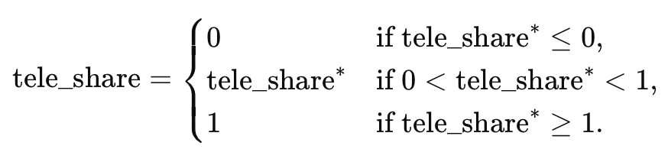
Composition (Model 4): Telehealth Share of Care
Research Question: Does socioeconomic status or insurance predict the proportion of all outpatient care that children receive via telehealth (telehealth share = telehealth visits ÷ total visits)?
Why Tobit? tele_share is bounded (0–1), heavily left-censored at 0, and occasionally right-censored at 1.
RESULT
SES Gradient: High-Income Children Use Telehealth for a Larger Share of Care
Children >400% FPL have significantly higher telehealth share (β = 0.28, p = 0.022). Middle-income is borderline significant (β ≈ 0.19, p = 0.091).
Insurance Gap: Uninsured Children Rely Least on Telehealth
Racial Differences Are Evident. NH Black children have significantly lower telehealth share (β = –0.31, p = 0.016). Asian differences are directionally similar but not significant.
High Clinical Need Strongly Increases Telehealth Share
Notes:
Why Tobit?
tele_share is bounded (0–1), heavily left-censored at 0, and occasionally right-censored at 1.
Tobit correctly models the censored distribution; OLS or fractional logit would mis-handle the mass at zero.
Tobit regression analysis of the proportion of care delivered via telehealth confirmed that socioeconomic status dictates the composition of pediatric care. Children in high-income households (>400% FPL) relied on telehealth for a significantly larger share of their total outpatient visits compared to children in poverty ($\beta$=0.28, p=0.022). Uninsured children and Non-Hispanic Black children had significantly lower telehealth shares (p=0.030 and p=0.016, respectively), suggesting that for these groups, outpatient care remains overwhelmingly tied to physical brick-and-mortar settings. Conversely, for children with Special Health Care Needs (CSHCN), telehealth comprised a significantly larger proportion of their total provider interactions (p<0.001).

Slide 21
Summary
High-income children had ~3× more telehealth visits and ~60% more in-person visits.
Uninsured children had ~94% fewer telehealth visits (IRR ≈ 0.06).
NH Black children had 30–60% lower use across models.
CSHCN children had 4× more in-person visits and 10× more telehealth visits.
Telehealth share dropped from ~4–10% (2021) to ~2–4% (2023) across SES groups.

Slide 22
Model 5: Poverty × Year Interaction (Telehealth Visits)
Research Question: Is the SES gap in telehealth visit counts narrowing, widening, or stable from 2021–2023?
RESULTS
Telehealth visits fall sharply for all poverty groups over time.
No Poverty × Year interaction is significant → gaps do not narrow or widen.
High-income children consistently have the highest use, poor children the lowest.
Decline is parallel across SES groups, indicating a system-wide contraction, not SES-specific change.
Notes:
Why Negative Binomial?
Telehealth visit counts are over-dispersed (variance >> mean). Poisson would misfit; NB handles this correctly.
Analysis of in-person visits definitively supported the supplementation hypothesis. Rather than relying on telehealth as a substitute, high-income children utilized in-person care at a rate 60% higher than children in poverty (IRR 1.60; p<0.001). This pattern indicates that wealthier families access telehealth as an additional layer of service on top of robust traditional care usage. Conversely, children in poverty had the lowest utilization rates across both digital and physical modalities. Racial disparities were consistent across settings, with Non-Hispanic Black (IRR 0.68) and Asian (IRR 0.74) children utilizing significantly less in-person care than Hispanic children.
Interaction analysis of poverty and year (Model 5) indicated that the socioeconomic divide in telehealth adoption significantly widened over the study period. In 2021, children in high-income households (>400% FPL) utilized telehealth at approximately 2.2 times the rate of children in poverty (predicted mean visits: 1.08 vs. 0.48). By 2023, while utilization among children in poverty plummeted to near-zero levels (0.12 visits; 95% CI: 0.03–0.20), utilization among high-income children rebounded (0.54 visits; 95% CI: 0.09–1.00). Consequently, the relative disparity grew substantially; by 2023, high-income children were utilizing telehealth at roughly 4.5 times the rate of their low-income peers, suggesting that telehealth has evolved into a supplementary service primarily accessible to wealthier families rather than a safety net for the underserved.

Slide 23
The “Killer” Finding
Key Takeaway:
  The "relative gap" doubled from 2.2x (2021) to 4.5x (2023).
  Telehealth is not bridging the access gap; it is becoming a luxury good.
Notes:
The plot shows that high-income children consistently have the highest predicted telehealth visit counts in every year, while poor and low-income groups remain substantially lower. The lines move in roughly parallel fashion with overlapping confidence intervals, indicating no meaningful convergence or widening of the poverty gap over time.
Title: The Digital Divide is Getting Worse (2021–2023)
2021 (Pandemic Peak):
Telehealth widely used, but Wealthy use 2x more than Poor.
High Income: 1.08 visits | Poor: 0.48 visits
2023 (Post-Pandemic):
Telehealth disappears for the Poor but stabilizes for the Wealthy.
High Income: 0.54 visits | Poor: 0.12 visits

Slide 24
Limitations
Heavy Zero-Inflation & Censoring
Most children had zero telehealth visits, creating strong left-censoring for Tobit and overdispersion for count models; estimates are stable but inherently imprecise for rare users.
SES & Insurance Misclassification
MEPS captures current annual insurance and family income, not month-to-month churn or precise eligibility thresholds, limiting sensitivity of SES contrasts.
Behavioral vs. Non-Behavioral Care Cannot Be Cleanly Separated
MEPS does not reliably distinguish mental/behavioral telehealth from general medical telehealth, which matters because uptake patterns differ sharply by specialty.
Cross-Sectional Pooled Design NOT Causal Inference
Years 2021–2023 are pooled person-years; without panel tracking, within-child changes in telehealth use cannot be measured, and year effects remain descriptive, not causal.
Potential Unmeasured Confounding
Digital access (device availability, internet quality), parental work flexibility, provider telehealth policies, and state-level telehealth mandates are not observed, leaving residual confounding.
Small Telehealth Subsample
The analytic sample collapses when conditioning on telehealth users; high-income and CSHCN groups disproportionately drive model precision, making subgroup comparisons less stable. MEPS is a household survey. It excludes children in institutions
Pandemic Recovery Context
The period (2021–2023) reflects post-COVID contraction of telehealth; findings may not generalize to stable, post-policy environments.
The "Digital Redlining" Blind Spot (Omitted Variable Bias)
Model does not control for broadband access or digital literacy.
Notes:
Finally, this study has several limitations. First, MEPS data relies on parent-reported utilization and health status, which subjects our findings to recall and social desirability biases. Second, the survey does not consistently distinguish between video and audio-only modalities; consequently, we could not assess disparities in the quality of telehealth encounters. Third, we were unable to control for household broadband access or state-level variations in telehealth reimbursement policies, both of which are likely unobserved drivers of the divergent trends seen in 2023. Future research should leverage administrative claims data to disentangle the impact of payment parity laws from patient-level socioeconomic barriers.

Slide 25
Conclusion and Policy Implications
The Digital Divide Persists
Telehealth in the post-pandemic period primarily functioned as a "luxury" supplement for higher-income families, not a safety net for the vulnerable.
Uninsured are Excluded
Children without insurance are effectively locked out of the telehealth revolution, reinforcing disparities.
Policy Recommendation
Without targeted policy action (broadband subsidies, reimbursement parity for safety-net providers), telehealth may reinforce rather than ameliorate socioeconomic disparities in pediatric care.
Notes:
Telehealth is disproportionately augmenting care for higher-income families, risking widening disparities. Policy needs:
Broadband subsidies targeted to low-income households.
Reimbursement parity to support safety-net providers.
Coverage protections for telehealth within Medicaid/CHIP

Slide 26
Source Material:
Khatiwada, P. (2025). "Disparities in Pediatric Telehealth Engagement and Care Substitution: A National
Analysis, 2021–2023". [Unpublished Class Project]. Medical Expenditure Panel Survey (MEPS) 2021-2023 Public Use Files.
Thank You
Questions?
NEXT >>
Step [Immediate] to strengthen the paper:
Add mechanisms + robustness checks + narrative/context explaining the decline.
Step to deepen the research:
Pull in new MEPS variables (digital access), merge state-level telehealth policy/broadband data, and situate findings in recent literature.
Notes:
Happy to take questions on methodology, model choice, MEPS structure, or policy implications.

